Slide 1
MUST/ MUSTN’T
AT Home AT, School, In the Hospital, At the library, on the bus

Slide 2
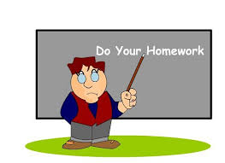
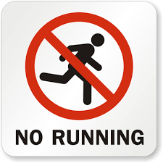
When do we use must/ musn’t?
We use must to talk about an obligation, something you have to do, for example:
You must do your homework.
We use mustn’t to say that something is not permitted or allowed, for example:
You mustn´t run near the pool.

Slide 3
At school
You must …
be on time.
pay attention in class.
listen to your teacher and your classmates.
bring your materials.
You mustn’t
eat in class.
disturb your classmates.
use your cellphones in class.
be rude.

Slide 4
AT HOME
You must …
obey your parents.
help your parents.
respect your family.
You mustn’t
insult your brothers or sisters.
throw rubbish on the floor.

Slide 5
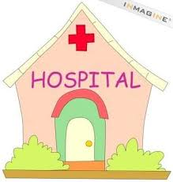
IN the Hospital
You must …
be respectful with other people.
speak softly.
You mustn’t …
run.
shout.
smoke.

Slide 6
Positive | Negative | Question
Subject +must + main verb | Subject + mustn´t +main verb | Must + subject + main verb
You must listen to your parents. love song. They must wear a helmet when they ride their bikes. City. | You mustn´t use your cell phone when you drive. They mustn´t forget their helmets when they ride their bikes. | Must we memorize the presentation? a love song? Must they buy tickets in advance for the movie?

Slide 7
In short answers…
http://englishteacherloli.blogspot.com/2014/06/must-mustnt.html

Slide 8
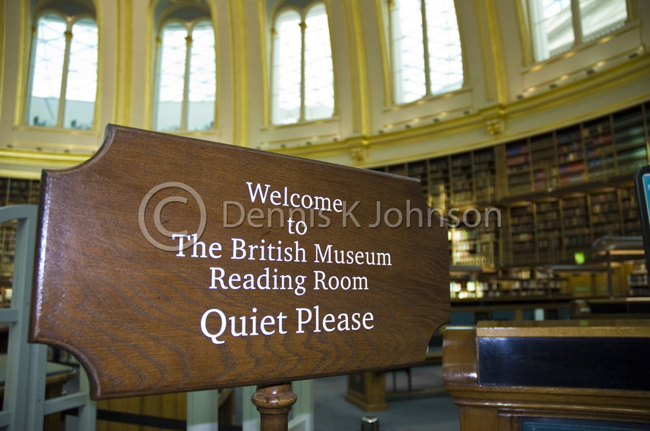
what’s the order?
Put the words in the correct order to make rules for a museum.
quiet- You- must -be ____You must be quiet.______
take- You- photos- mustn’t _____________________
must -be –You- careful _________________________
You- touch- mustn’t- exhibits ____________________
run -mustn’t- You ______________________________
rules!- must- You- follow- the _____________________

Slide 9
What’s the order?
Put the words in the correct order to make rules for a museum.
You must be quiet.
You mustn´t take photos.
You must be careful.
You mustn’t touch exhibits.
You mustn´t run.
6. You must follow the rules.

Slide 10
Let’s practice!
Complete the sentences with must or mustn´t
You ______________ brush your teeth every day.
You ______________ fight with your classmates.
You _______________ chew gum in class.
You ________________ stay in bed when you are sick.
You _________________ be nice to your classmates.
You _________________ forget to do your homework.

Slide 11
Let’s practice!
Complete the sentences with must or mustn´t:
You must____ brush your teeth every day.
You mustn’t__ fight with your classmates.
You mustn’t___ chew gum in class.
You must_____ stay in bed when you are sick.
You must_____ be nice to your classmates.
You mustn’t__ forget to do your homework.

Slide 12
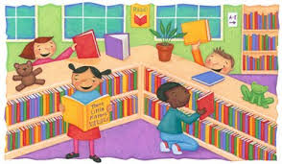
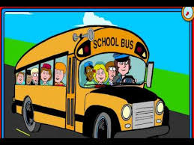
Let’s practice!!!
Work with your partner and write rules using must and mustn’t (3 rules):
At the library
picturesof.net
On the bus
youtube.com

Slide 13
In your notebook,copy and complete these sentences using must/ mustn’t
She is ill, so she_________ see the doctor.
It is raining. You_________ take your umbrella.
This is a secret. You_________ tell anybody.
You _________ make noise in the library.
We _________ hurry or we will miss the bus.
You ________ eat fruit and vegetables to be healthy.
The baby is sleeping. You __________ shout.

Slide 14
www.callcentre.co.uk

