Slide 1
Must or mustn’t
Obligation and prohibition

Slide 2
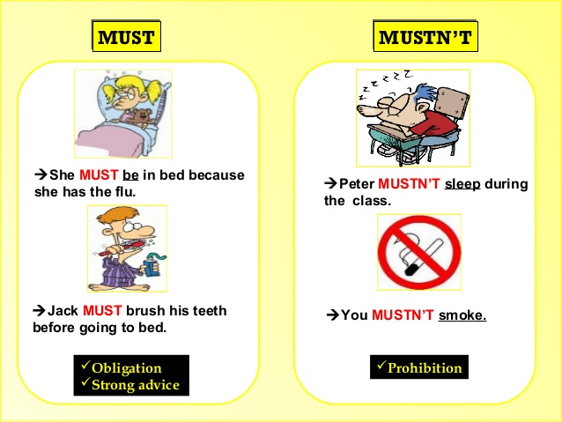
How do we use must or musn’t
cristinamolero.es

Slide 3
Are these sentences true (t) or false (f)?
You must wash your hands before lunch. _______
You mustn’t listen to your parents. _______
You must break the windows at school. _______
You must eat lots of sweets if you want to lose some weight.
_______
You must feed your dog every day. _______

Slide 4
Are these sentences true (t) or false (f)?
You must wash your hands before lunch. _______
You mustn’t listen to your parents. _______
You must break the windows at school. _______
You must eat lots of sweets if you want to lose some weight.
_______
You must feed your dog every day. _______
T
F
F
F
T

Slide 5
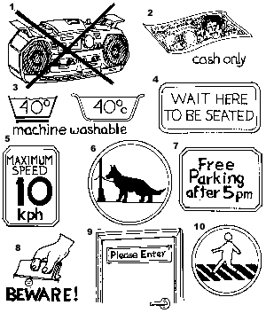
What must or mustn’t we do?
Write sentences in your notebook related to these pictures.
Ex:
1. You musn’t listen to music during the test.

Slide 6
In your notebook,copy and complete these sentences using must/ mustn’t
She is ill, so she_________ see the doctor.
It is raining. You_________ take your umbrella.
This is a secret. You_________ tell anybody.
You _________ make noise in the library.
We _________ hurry or we will miss the bus.
You ________ eat fruit and vegetables to be healthy.
The baby is sleeping. You __________ shout.

Slide 7
In your notebook,copy and complete these sentences using must/ mustn’t
She is ill, so she_________ see the doctor.
It is raining. You_________ take your umbrella.
This is a secret. You_________ tell anybody.
You _________ make noise in the library.
We _________ hurry or we will miss the bus.
You ________ eat fruit and vegetables to be healthy.
The baby is sleeping. You __________ shout.
must
must
mustn’t
mustn’t
must
must
mustn’t

Slide 8
www.callcentre.co.uk

