Slide 1
Personality Traits

Slide 2
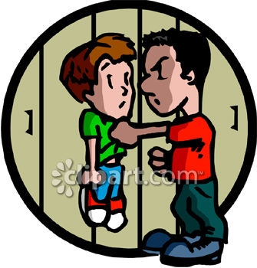
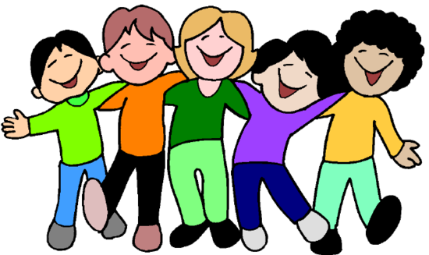
Kind

Slide 3
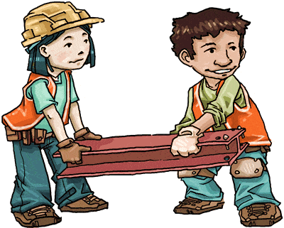
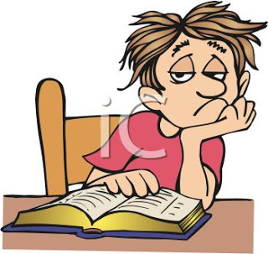
Hard-working

Slide 4
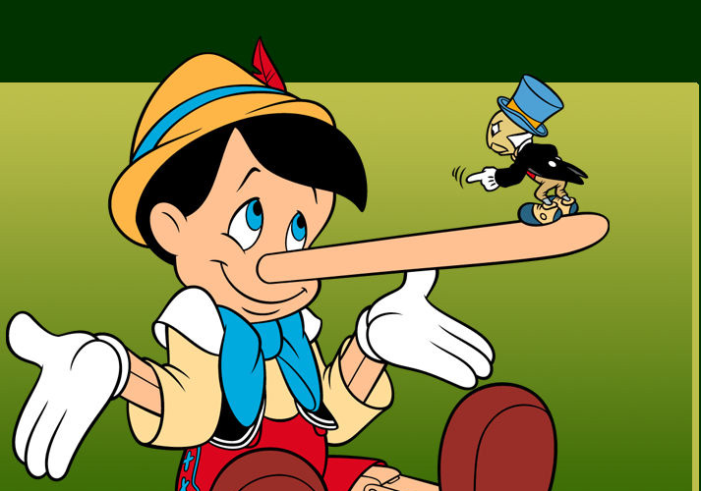
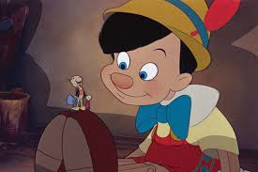
Honest

Slide 5
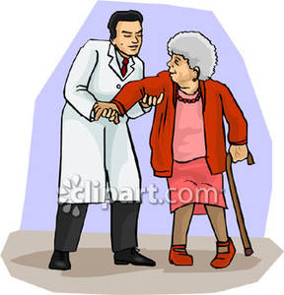
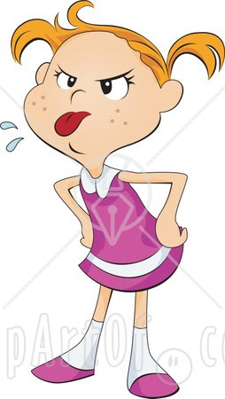
Polite

Slide 6
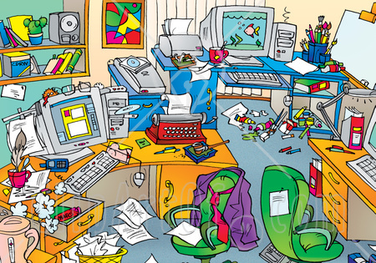
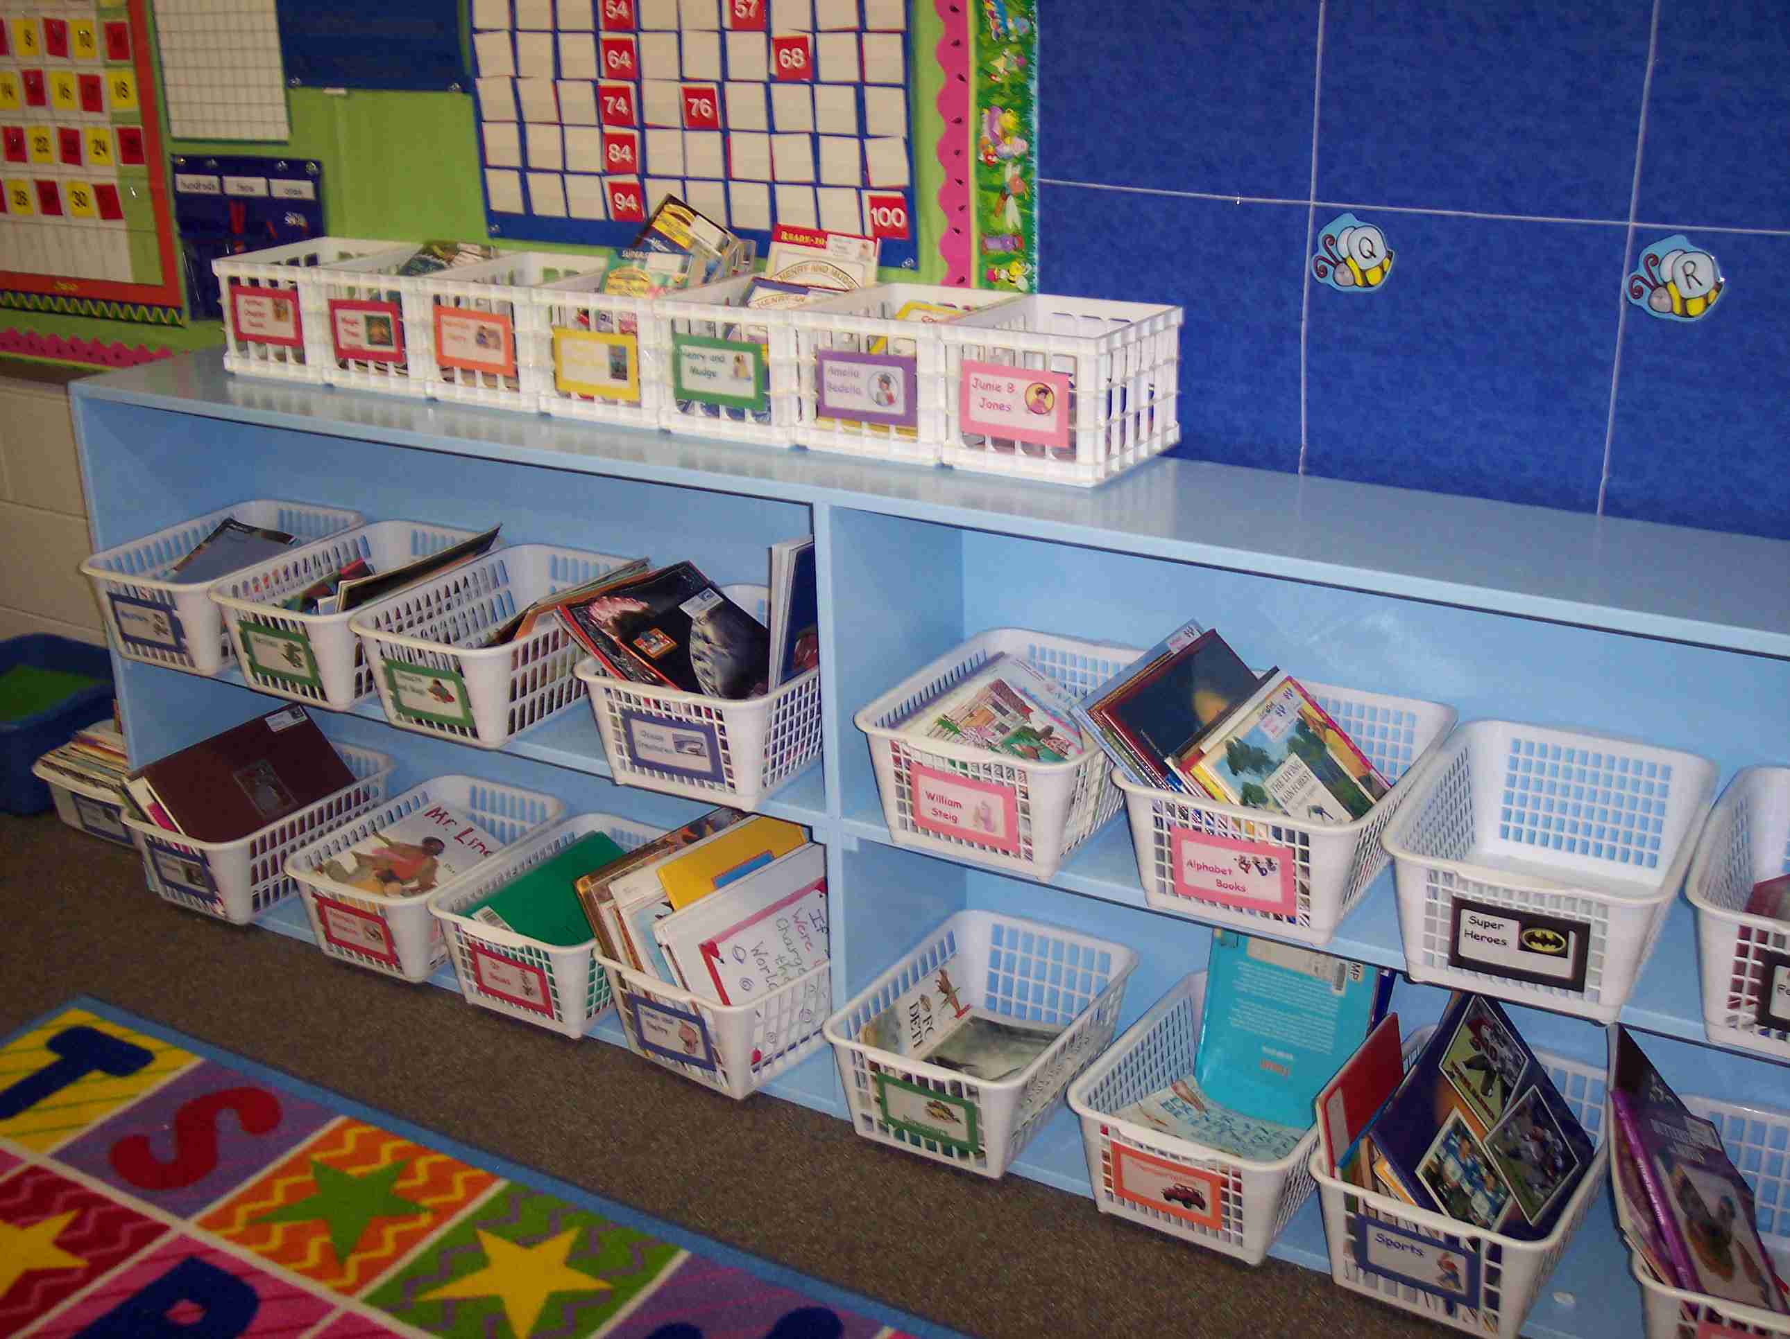
Organized

Slide 7
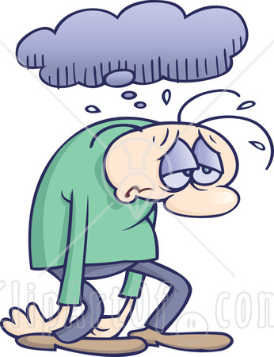
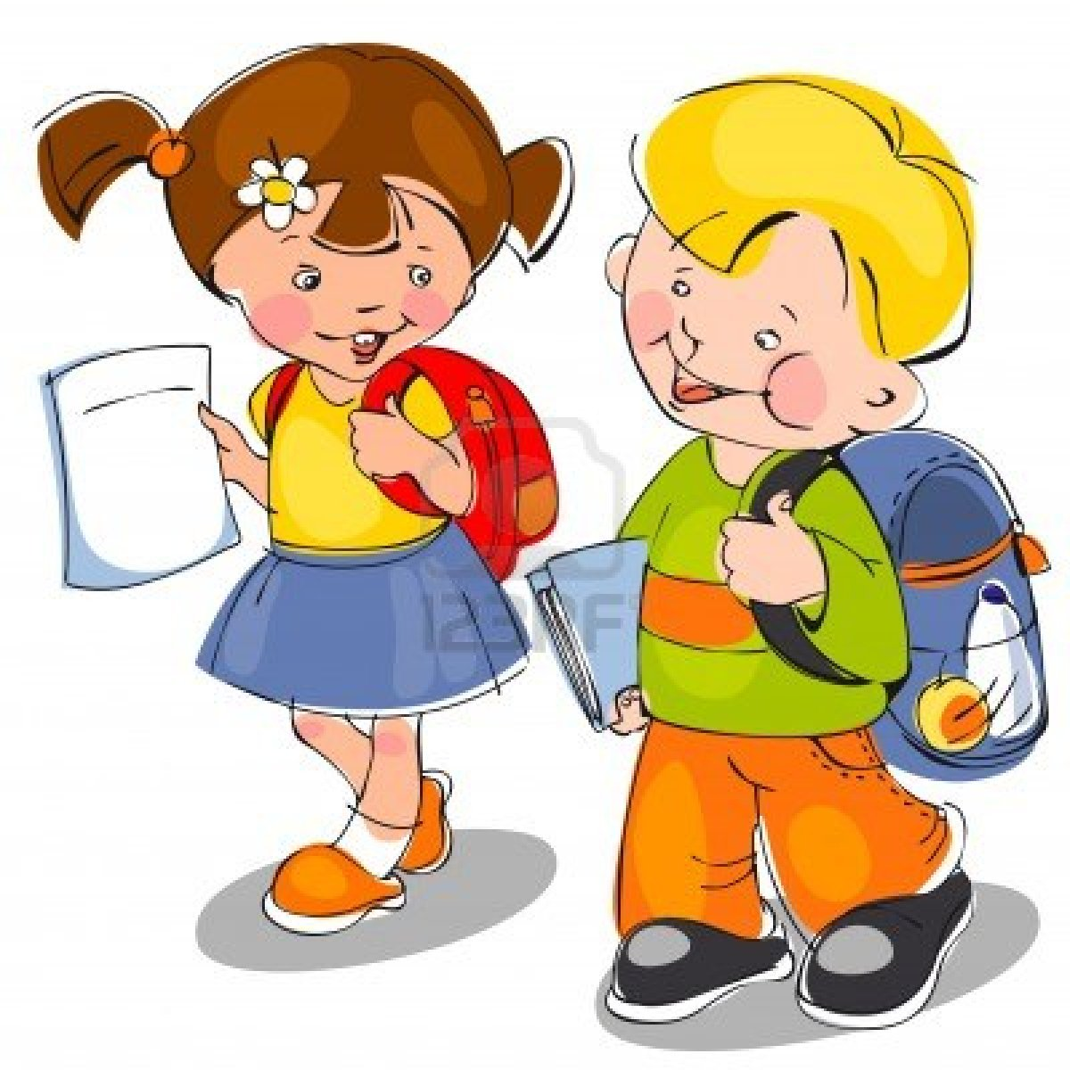
Cheerful

Slide 8
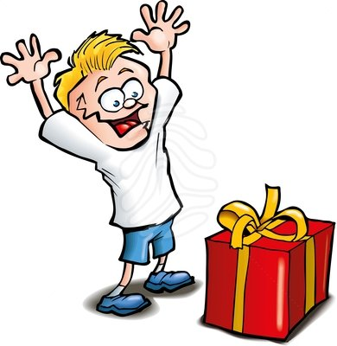
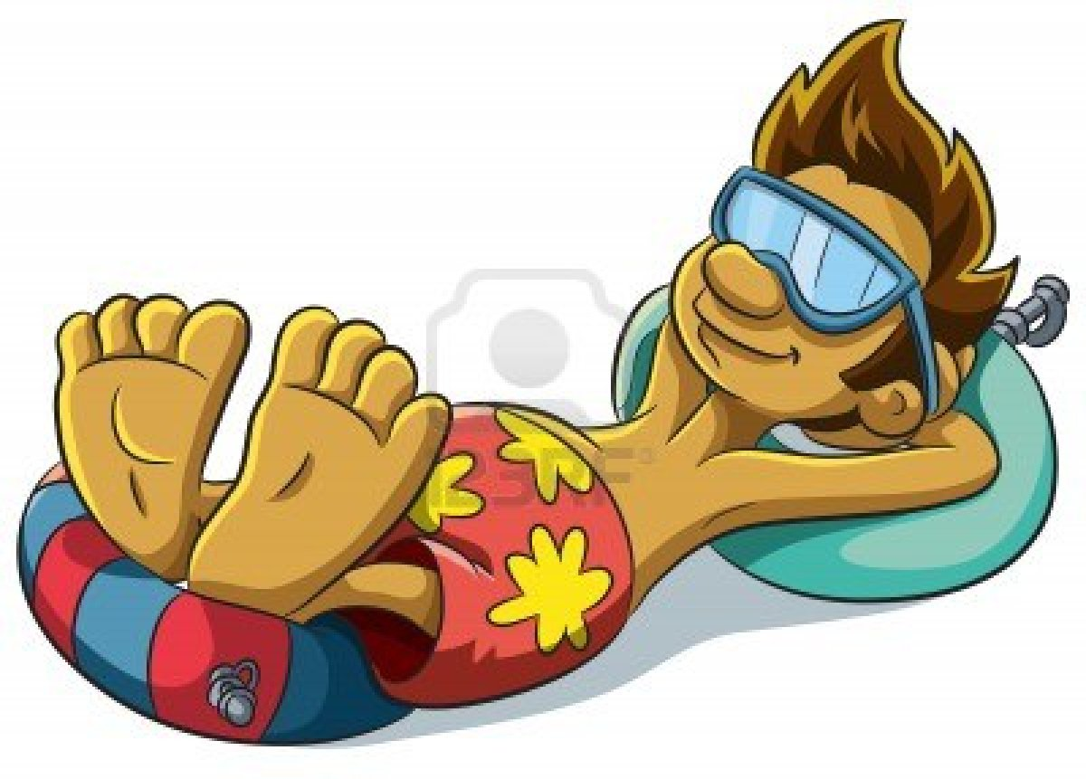
Relaxed

Slide 9
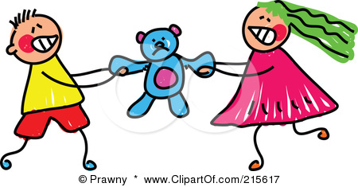
Friendly

Slide 10
Let´s practice!

Slide 12
Opposites! Can you complete the table with opposite traits?
relaxed
 | disorganized
kind
polite
 | miserable
friendly
 | dishonest

Slide 13
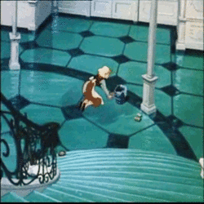
Cinderella cleans and orders the house. She is very_________________.
Organized.

Slide 14
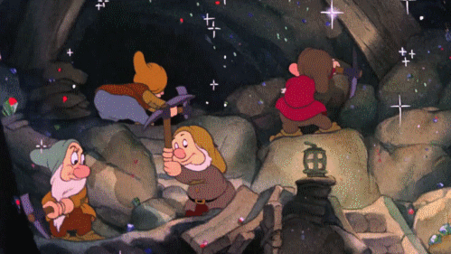
The seven dwarfs work all day long. They are _____________________________.
Hard workers.

Slide 15
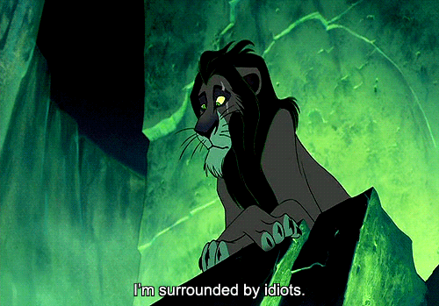
Scar has no friends. He is not easy to talk to and thinks people are idiots. He is _______________________.
unfriendly.

Slide 16
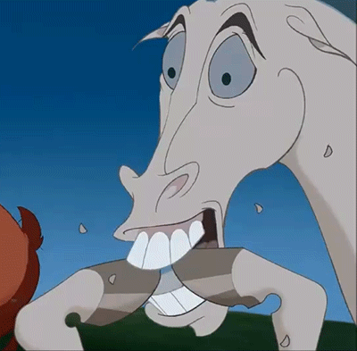
The horse is not relaxed. He keeps biting his nails. He is ______________________________.
nervous.

Slide 17
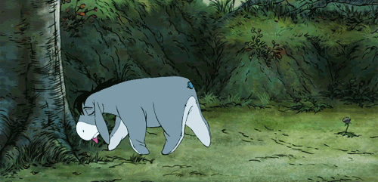
Eeyore is always sad and never smiles. He is _____________________.
miserable.

Slide 18
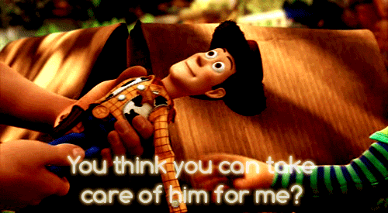
Andy gives Woody to the little girl. He was very ____________________.
kind.

Slide 19
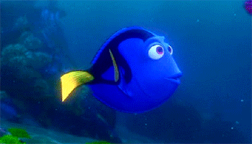
Dory is always happy and always thinks about the best outcomes. She is ________________________.
cheerful.

Slide 20
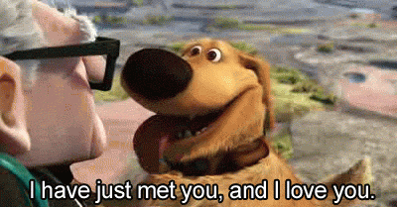
Doug easily makes friends and loves to be around people. He is ___________________________.
friendly.

Slide 21
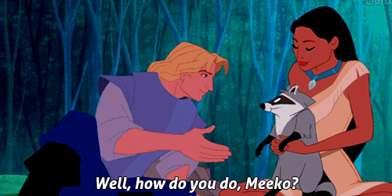
Meeko doesn’t say hello, please or thank you. He is _______________________.
rude.

Slide 22
Guess Who?
Write down 3 personality traits to describe yourself.
Then, we will read the adjectives, and guess who!

