Slide 1
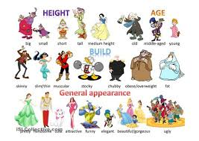
Physical Traits
6th Grade 2016

Slide 2
Height
Tall Medium Short

Slide 3
Weight
Thin Average Chubby

Slide 4
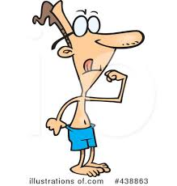
Body Build
Athletic or Muscular or
strong
Weak

Slide 5
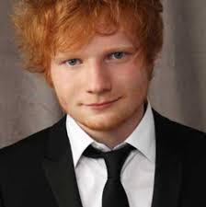
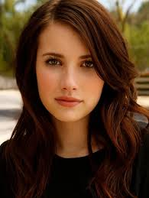
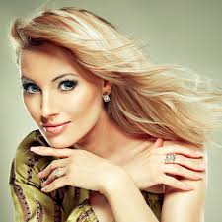
Hair Color
Black Hair Brown Hair Red Hair Blonde hair
brunette red-head blonde

Slide 6
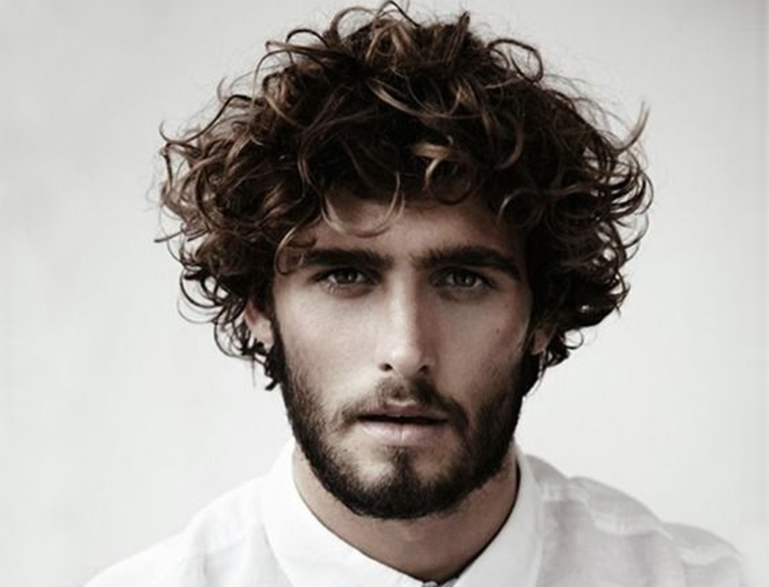
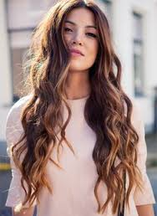
Kinds of Hair
Straight Hair Wavy Hair Curly Hair
Long Hair Long Hair Short Hair

Slide 7
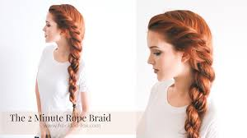
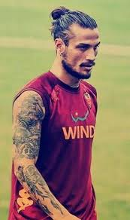
Hair Styles
Braid
Bun

Slide 8
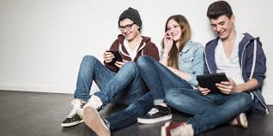
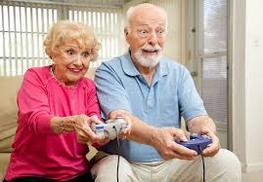
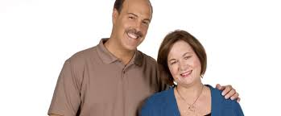
Age
teenagers
old or elderly
young kids
middle-aged

Slide 9
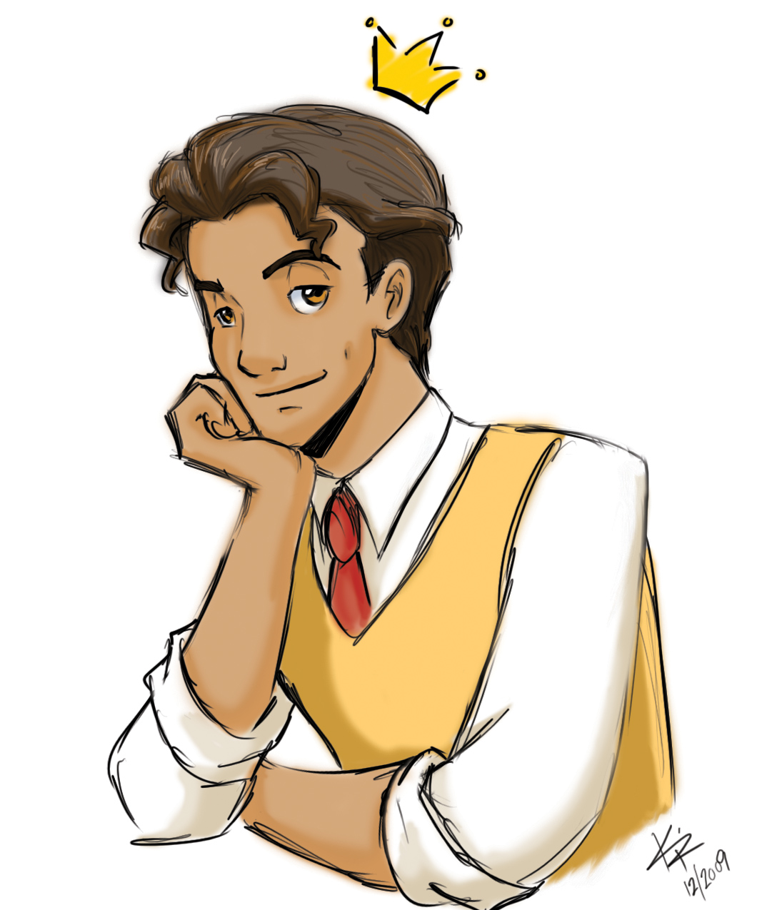
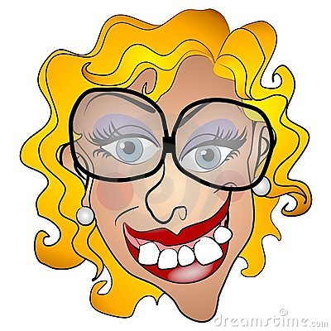
Appearance
cute/Attractive
beautiful
handsome
uggly

Slide 10
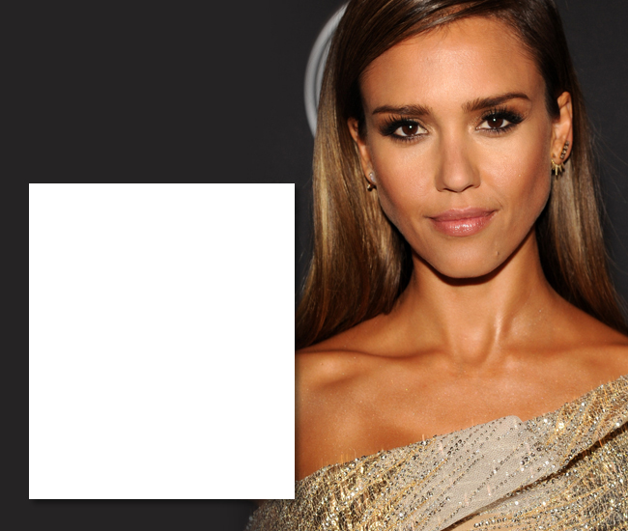
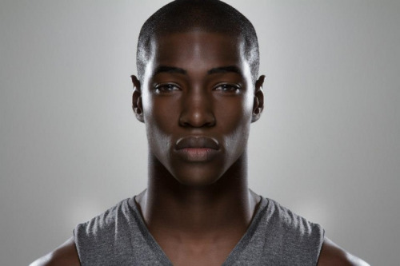
Skin color
Dark-skinned
Fair-skinned
Tanned

Slide 11
Eye color

Slide 12
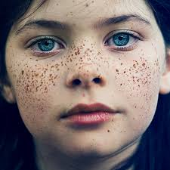
Faces
Freckled face
Wrinkled face

Slide 13
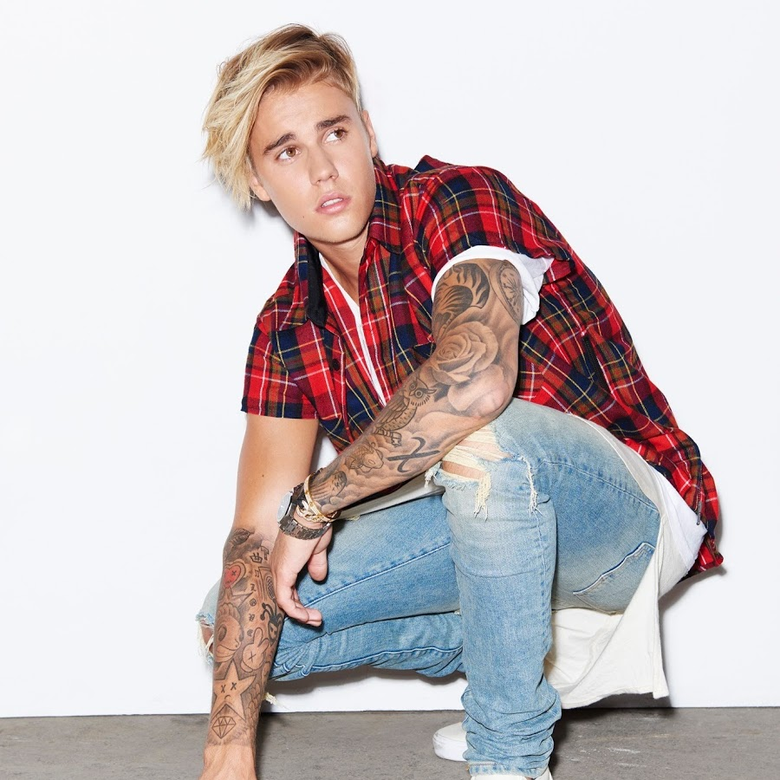
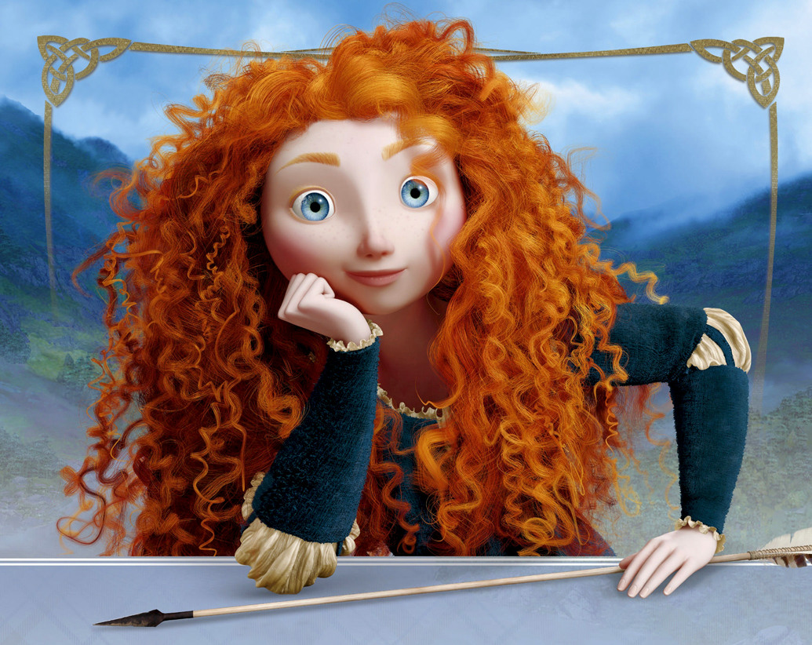
Describe these characters
Elsa is _____________________________.
Elsa has ____________________________.
Justin Bieber is handsome.
Justin Bieber has brown eyes and
blonde hair.
Merida is _____________________________.
Merida has _______________________________.

Slide 14
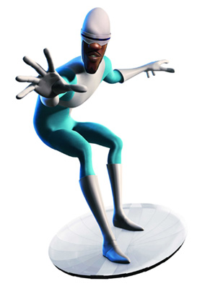
Agnes is ___________________________ .
Agnes has __________________________.
Frozone is _____________________.
Frozone has ____________________.

Slide 15
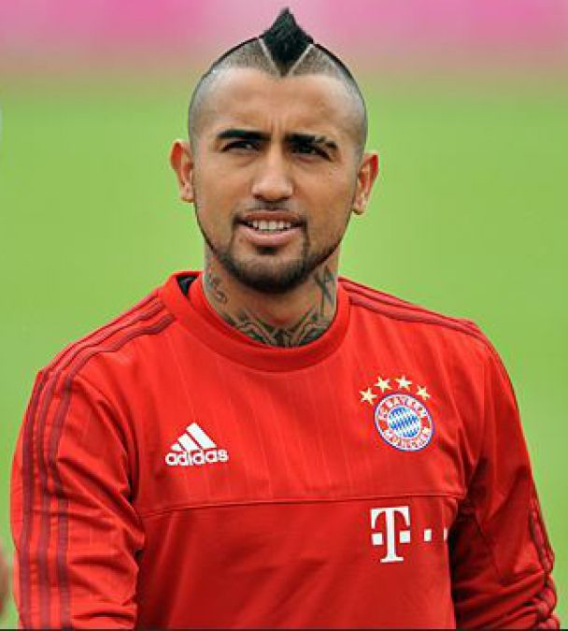
Beyoncé is ____________________.
Beyoncé has __________________.
Arturo Vidal is ______________.
Arturo Vidal has ____________.

