Slide 1
Should and shouldn’t
Giving advice
6th grade, bimester 4

Slide 2
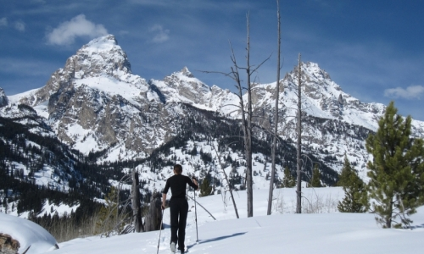
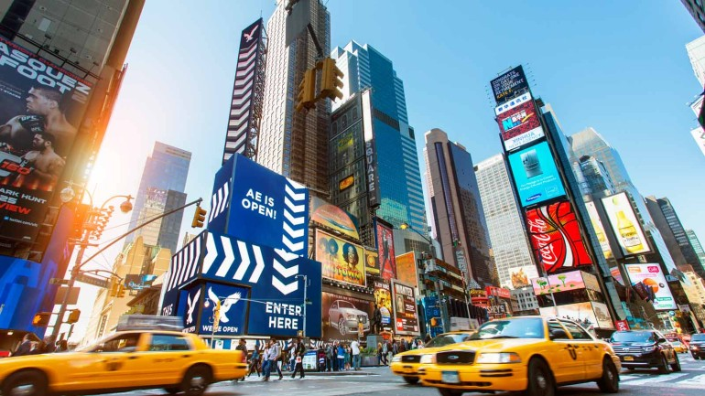
Help me please! Where should I go on vacations?
www.premiercancunvacations.com
www.jacksonholewy.net
ww.bertelsmann.com

Slide 3
www.slideshare.net

Slide 4
Positive | Negative | Question
Subject + should + main verb | Subject + shouldn´t +main verb | Should + subject + main verb
You should listen in class. love song. They should visit their grandparents. . | You shouldn´t be late to a class. They shouldn´t go out without telling their parents. | Should we bring cake for the party? a love song? Should they buy tickets in advance for the movie?

Slide 5
Write the sentences in your notebook.
tx.english-ch.com

Slide 6
Match the situation with the appropriate advice:
You should buy a gift. A) The class is finishing a test.
Megan should take a nap. B) I arrived late to school.
The students shouldn´t listen to loud music. C)She just returned from a long flight.
Jake should wear sun screen. D) It is your cousin´s birthday.
I should wake up earlier. E) His family is going to the beach.
https://elt.oup.com/student/project3rdedition/level3/unit6/grammar/exercise1?cc=cl&selLanguage=en

Slide 7
Listening Activity https://www.youtube.com/watch?v=cLQJVKP3YlM
Darling you got to let me 1. know/now Should I stay or should I go? If you say that you are 2. fine/mine I'll be here 'til the end of time So you got to let me know Should I 3. play/stay or should I go?
It's always tease, tease, tease You're happy when I'm on my 4.feet/ knees One day it's fine and next it's black So if you want me off your 5. pack/back Well, come on and let me know Should I stay or should I go?
Should I stay or should I go now? Should I stay or should I go now? If I go, there will be 6.trouble double And if I stay it will be 7.trouble double So come on and let me know
This indecision's bugging me If you don't want me, set me free Exactly whom I'm supposed to be
Don't you know which 8. shoes/clothes even fit me? Come on and let me know Should I cool it or should I blow?
Repeat lyrics Read more: The Clash - Should I Stay Or Should I Go? Lyrics | MetroLyrics
What do you think?
Should he stay or should he go away from his girfriend?

Slide 8
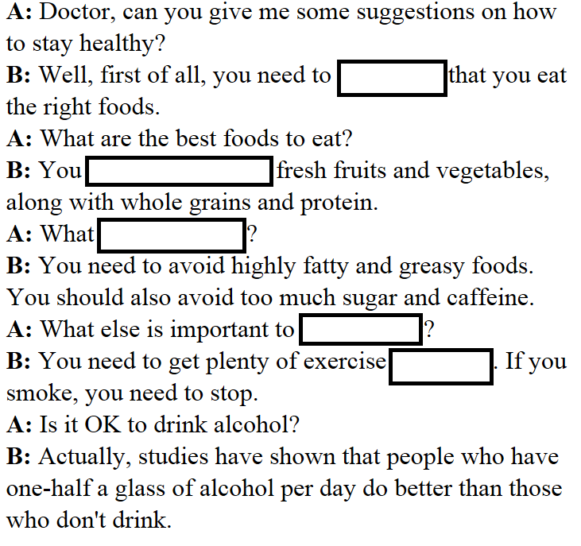
Complete the conversation with the words you hear.
http://www.eslfast.com/robot/topics/health/health25.htm

Slide 9
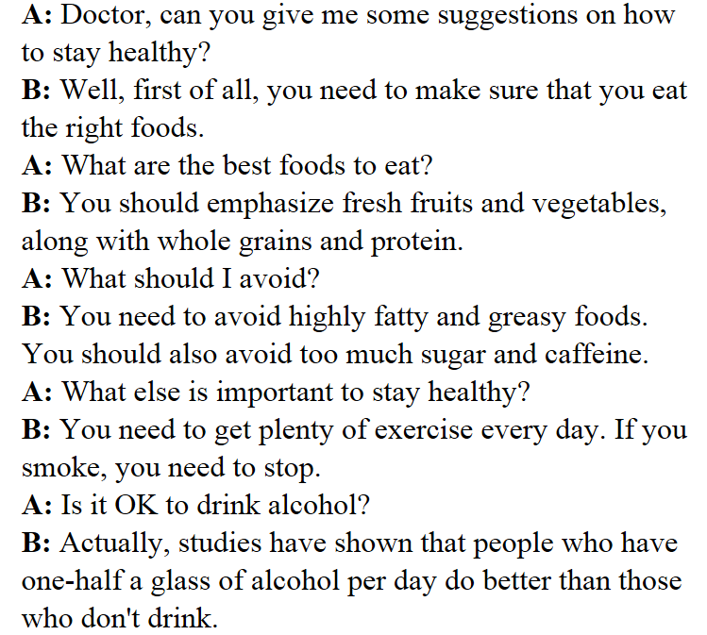
Checking dialogue

Slide 10
Practice!
Work with a partner to give advice to the people in the following situations.
Please write down the sentences in your notebooks.

Slide 11
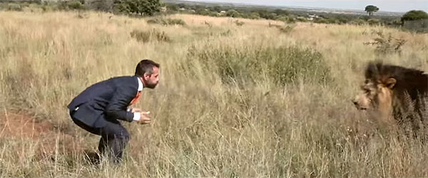
What should you do in each situation?
He should___________________
He should___________________
He shouldn’t_________________
He shouldn´t________________
www.viralnova.com

Slide 12
What should you do in each situation?
She should___________________
She should___________________
She shouldn’t_________________
She shouldn´t________________
www.dailytech.com

Slide 13
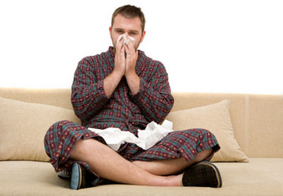
What should you do in each situation?
The sick man should___________________
The sick man should___________________
The sick man shouldn’t_________________
The sick man shouldn´t________________
www.care2.com

Slide 14
Well done!!!
www.keepcalm-o-matic.co.uk

