Slide 1
What are we going to do??
Simple Future Tense
6th Grade 2016

Slide 2
The verb to be + going to + infinitive
In English it is very common to describe future actions using the phrase “going to”
Examples:
Tomorrow, I am going to ski.
After school, my sister is going to shop.
On the weekend, we are going to visit my grandma.

Slide 3
Remember the verb to be?
I | We
You
He She It | They

Slide 4
Remember the verb to be?
I am | We are
You are
He She is It | They are

Slide 5
Positive | Negative | Question
Subject + verb to be + going to+ main verb | Subject + verb to be + not + going to + main verb | Verb to be + subject + going to + main verb
Taylor Swift is going to write a love song. Batman is going to save Gotham City. | Taylor Swift is not going to write a love song. Batman isn´t going to save Gotham | Is Taylor Swift going to write a love song? Is Batman going to save Gotham?

Slide 6
Going to be structure
Positive | Negative | Question
Subject + verb to be + going to+ main verb | Subject + verb to be + not + going to + main verb | Verb to be + subject + going to + main verb
Taylor Swift is going to write a love song. | Taylor Swift is not going to write a love song. | Is Taylor Swift going to write a love song?
Batman is going to save Gotham City. | Batman isn´t going to save Gotham | Is Batman going to save Gotham?

Slide 7
Unscramble these sentences:
1. aren´t/eat/we/at Tiramisu/going to.
2. going to/my sister/play basketball/next week/is.
3. they/do/going to/a concert in Santiago/in 2016/are/?
4. study/you/for the math test/are/ tonight/going to/?
5. to leave/he/going to/isn´t/Chile/this year

Slide 8
When to use the going to structure
We use this structure to make PREDICTIONS or PLANS.
Write a prediction about what is going to happen in the photo using the BE GOING TO Structure.

Slide 9
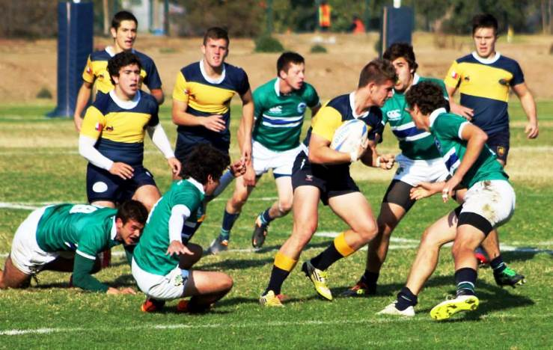
Who is going to win? Who is going to lose?

Slide 10
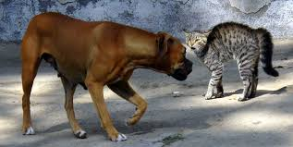

Slide 12
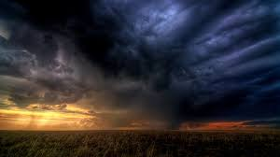

Slide 14
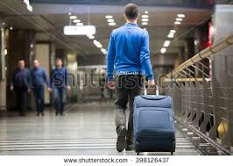

Slide 16
Be organized! Make yourself a to-do list for the week-8 responsibilities!
My to-to list:
I am going to wash my clothes
I am going to prepare for clases
I am going to call my friend in the USA

